Slide 1

RUNGTA COLLEGE OF DENTAL SCIENCES & RESEARCH
TITLE OF THE TOPIC
REGRESSIVE ALTERATIONS OF TOOTH
DEPARTMENT OF ORAL PATHOLOGY & MICROBIOLOGY

Slide 2

RUNGTA COLLEGE OF DENTAL SCIENCES AND RESEARCH
BHILAI (C.G)
DEPARTMENT OF ORAL PATHOLOGY
GUIDED BY:
DR. SIDDHARTH PUNDIR
DR. SUDHANSHU DIXIT
PRESENTED BY:
AASTHA MUDGAL
INTERN BATCH 2017

Slide 3
Specific learning Objectives
Core areas* | Domain ** | Category #
Attrition, Abrasion, Erosion and Abfraction | COGNITIVE | MUST KNOW
Dentinal Sclerosis | COGNITIVE | MUST KNOW
Dead Tracts | COGNITIVE | MUST KNOW
Secondary Dentin | COGNITIVE | MUST KNOW
Reticular Atrophy of Pulp | COGNITIVE | MUST KNOW
Pulp Calcification | COGNITIVE | MUST KNOW
Resorption of Teeth | COGNITIVE | MUST KNOW
Hypercementosis | COGNITIVE | MUST KNOW
Cementicles | COGNITIVE | MUST KNOW

Slide 4
Index
Attrition, Abrasion, Erosion and Abfraction
Dentinal Sclerosis
Dead Tracts
Secondary Dentin
Reticular Atrophy of Pulp
Pulp Calcification
Resorption of Teeth
Hypercementosis
Cementicles

Slide 5
Regressive alteration
Are the group of retrogressive changes in the teeth, which occur due to non-bacterial causes & results in wear and tear of the tooth structures with impairment of function.
Some result from generalized aging process
Others duo to chronic persistent tissue injury

Slide 6
Tooth wear
Causes of tooth wear:
1. Attrition
2. Abrasion
3. Erosion
4. Abfraction

Slide 7
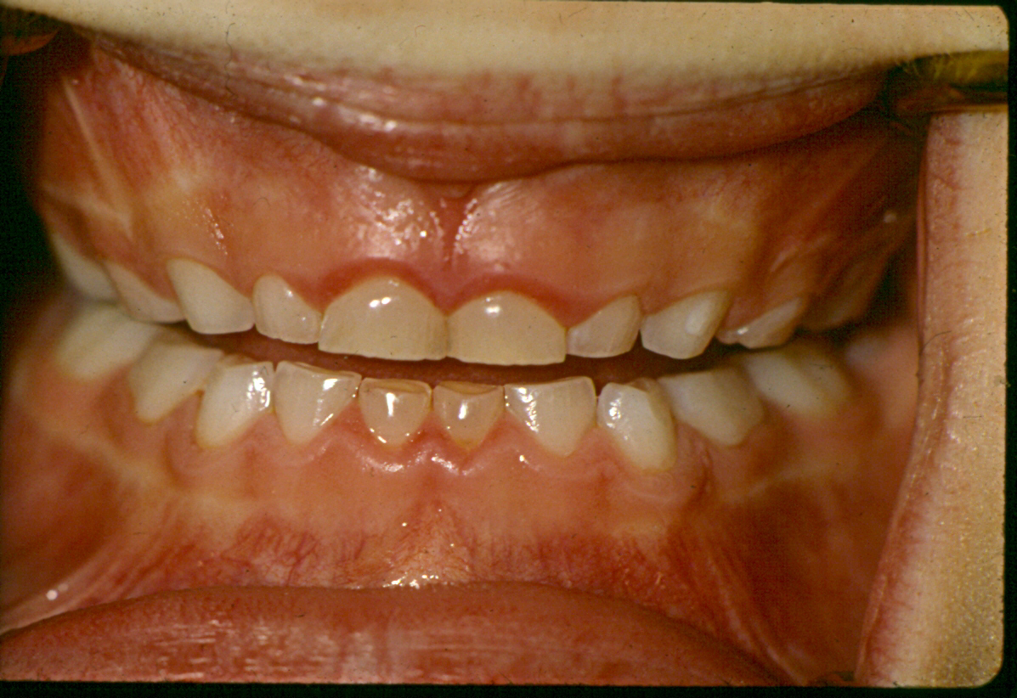
Attrition
Attrition may be defined as the physiologic wearing away of a tooth as a result of tooth-to-tooth contact, as in mastication.
This occurs only on the occlusal, incisal, and proximal surfaces of teeth, not on other surfaces unless a very unusual occlusal relation or malocclusion exists.
This phenomenon is physiologic rather than pathologic, and it is associated with the aging process.
The older a person becomes, the more attrition is exhibited.

Slide 8
The rate and severity of attrition depends upon several factors such as: Diet quality, dentition, force of the masticatory muscles and chewing habits, etc.
TYPES OF ATTRITION
Although clinical distinction is difficult to make, attrition may be divided into two types:
A.Physiological attrition
. B. Pathological attrition
Physiological Attrition
• The tooth loss in physiological attrition is fairly constant and is proportionate to the agePathological Attrition Pathological attrition occurs due to certain abnormalities in occlusion, chewing pattern or due to some structural defects in the teeth. It often causes extensive loss of tooth structure, which results in disturbed function and loss of esthetics. The tooth wear in this type of attrition does not maintain a consistent pattern and the amount of tooth loss is not proportionate to the age of the individual. of the individual.
• Physiological attrition begins with wearing of the incisal edge of incisors; it is followed by the palatal cusp of maxillary molars and buccal cusp of mandibular molars.
• Attrition also occurs in the proximal surfaces of teeth in the contact point areas.

Slide 9
Pathological Attrition.
Pathological attrition occurs due to certain abnormalities in occlusion, chewing pattern or due to some structural defects in the teeth.
It often causes extensive loss of tooth structure, which results in disturbed function and loss of esthetics.
The tooth wear in this type of attrition does not maintain a consistent pattern and the amount of tooth loss is not proportionate to the age of the individual.

Slide 10
CAUSES OF PATHOLOGICAL ATTRITION
• Abnormal occlusion
• Premature extraction of teeth
• Abnormal chewing habits
• Structural defects in teeth

Slide 11
CLINICAL FEATURES OF ATTRITION
• Attrition can occur in both deciduous as well as in the permanent teeth.
• Attrition of tooth is clinically manifested by the formation of flat, smooth, shiny, well-polished facets on those surfaces of teeth which come in contact with the opposing teeth.
• Thus, attrition often occurs on the tip of the cusps, incisal edges, on the proximal contact areas, labial surface of lower anteriors and palatal surfaces of upper anteriors.
• In advanced cases, attrition may lead to severe reduction in the cuspal height with complete wearing of enamel and flattening of the entire occlusal surface.
• When the enamel is lost on the occlusal surface, the dentin becomes attrited at a faster rate and the lesion may become cap shaped, surrounded by a rim of enamel at the periphery.
• When dentin becomes exposed it generally becomes discolored brown.
• Attrition in the proximal surfaces of teeth occurs due to vertical movements of tooth within the socket during mastication.
• Proximal surface attrition causes transformation of proximal “contact points” to relatively broad and flat “contact areas”.
• This type of loss of tooth structure from the proximal surfaces may even lead to mesial migration of teeth in the dental arch.
• Normally, men often exhibit more severe attritions of teeth than women.
• Exposure of dentinal tubules in severe cases of attrition may lead to tooth hypersensitivity.
• Pulp exposure and subsequent pain are rare in case of attrition as the process is generally slow, and often allows sufficient time for formation of protective reparative dentin.

Slide 12
• Attrition may also occur on the restorations of teeth. A common example in this regard, is the development of shiny facets on the amalgam filled surfaces.
• Attrition may even possibly lead to fracture of the cusps of teeth or restorations.
TREATMENT
Treatment of attrition is difficult; however certain things can be done to reduce further tooth wear.
• Corrections of developmental abnormalities causing traumatic occulusion.
• Correction of parafunctional chewing habits.
• Protection of tooth by metal or metalceramic crowns where structural defects (e.g. amelogenesis or dentinogenesis imperfecta) exist.
• Construction of occlusal guard, if the habit of bruxism is persisting.

Slide 13
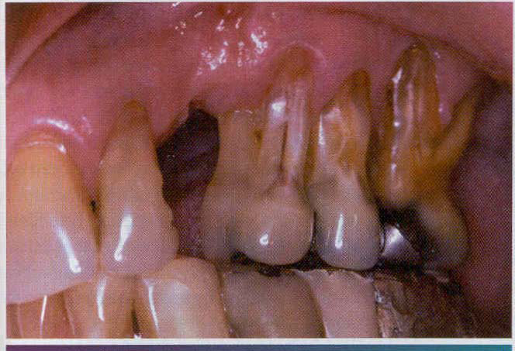
Abrasion
Abrasion is the pathologic wearing away of tooth substance through some abnormal mechanical process.
Abrasion usually occurs on the exposed root surfaces of teeth, but under certain circumstances it may be seen elsewhere, such as on incisal or proximal surfaces.
Robinson stated that the most common cause of abrasion of root surfaces is the use of an abrasive dentifrice.

Slide 14
Causes of abrasion
• Toothbrush abrasion
• Habitual abrasion
• Occupational abrasions
• Abrasions by prosthetic appliances
• Ritual abrasions.

Slide 15
CLINICAL FEATURES OF ABRASIONS
• In abrasion of tooth, the type and severity of surface wear will depend upon the duration and the type of faulty habit adopted by the person.
• Clinical manifestations differ in different types of habit, e.g. a defect in the tooth due to toothbrush abrasion will differ from that of the occupational abrasion or from the habitual abrasion.
• The abrasion produces a ‘v’ shaped or wedgeshaped horizontal cervical notch on the buccal surface of teeth. The notch will have sharp angles and highly polished dentin surface.
• Toothbrush abrasions commonly occur on the cervical areas of the labial or buccal surfaces of teeth.
• Canines and premolars being the more prominent teeth are often more severely affected by abrasion.
• Teeth on the left side of the arch are more severely involved in right-handed persons and vice versa.
• Maxillary teeth are more commonly affected than mandibular teeth.
• In cervical abrasion, lesions are more often wide than deep.
• Toothbrush abrasion may also cause gingival recession.
• In pipe smokers, abrasions develop on the insical surfaces of upper and lower anterior teeth. The lesion is characterized by a wellpolished notch, whose shape typically matches with the shape of the pipe stem used by the smoker.
• Abrasion caused by habitual holding of nails or needles or other small tools by the tailors or shoe makers or carpenters, etc. often produces a small, deep, well-polished ‘ditch’ on the incisal edge of teeth.

Slide 16
• Faulty use of tooth-prick or dental floss cause loss of dentin and cementum, especially of the root surfaces on the proximal walls of teeth.
• Severe abrasion (of any type) may cause opening up of the dentinal tubules and therefore, the patient may experience sensitivity in the affected teeth due to hot and cold substances.
• Secondary or reactionary dentin usually forms on the pulpal surfaces to protect the teeth from pulp exposures.
• In untreated cases, the lesion may deepen further and it may eventually expose the dental pulp with subsequent of pulpitis and other associated manifestations.
TREATMENT
Avoidance of abnormal brushing habits prevent abrasions, however in already developed cases, restorative treatment helps to keep the tooth surface intact and also it prevents further tooth wear.

Slide 17
TOOTH ABFRACTION
Abfraction is the pathologic loss of tooth enamel and dentin caused by biomechanical loading forces.
FORCES CAUSING ABFRACTION
• Static forces: Produced during swallowing, tongue thrusting and cleanching.
• Cyclic forces: Forces produced during chewing. These forces cause repeated flexure and ultimate material fatigue to the affected tooth at locations away from the point of loading.
CLINICAL FEATURES
• Abfraction causes breaking down of enamel on the buccal surface of tooth.
• People with open bite or very deep class I cavity are more prone to develop abfraction of tooth.
• Sensitivity of tooth, sign of traumatic occlusion and wearing on the occlusal surface are often seen.
• Stress lines on the tooth surface and sometimes fracture of the tooth may occur.
• Repeated failure of restorations on the cervical area due to damaging lateral forces.

Slide 18
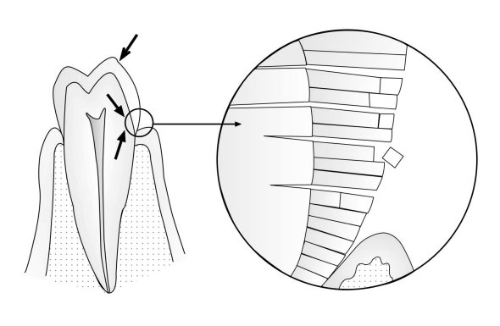
Abfraction
Loss of tooth structure that results from repeated tooth flexure caused by occlusal stresses.
Schematic view of abfraction – enamel prism fracturing due to stress effect of occlusal load which is focused on the area along the marginal edges of the crowns.

Slide 19
EROSION OF TEETH
Erosion can be defined as progressive irreversible loss of hard dental tissues by some chemical process that does not involve bacterial action
ETIOLOGIC FACTORS FOR EROSION
(A) EXTRINSIC FACTORS
Acidic Foods and Beverages
Medications- Some medicines can be highly acidic in nature (e.g. vitamin C and hydrochloric acid preparations, etc.) and they can cause erosion of teeth when chewed or kept in the mouth for a long time prior to swallowing.
Occupational erosions - Occupational erosions are seen among workers who often come in contact with acids at their place of work. Commonly vapors of different acids, e.g. chromic acid, hydrochloric acid, sulphuric acid and nitric acids, etc. are released into the work environment during industrial electrolyte process.

Slide 20
(B) INTRINSIC FACTORS
The intrinsic pathology of erosion means the acids are produced within the body and cause erosion of tooth. This type of erosion occurs in cases of certain systemic diseases, which cause increased vomiting and regurgitations of bowel contents into the mouth. When the gastric acids (having pH as low as below 1) come in contact with the teeth extensive erosions occur.

Slide 21
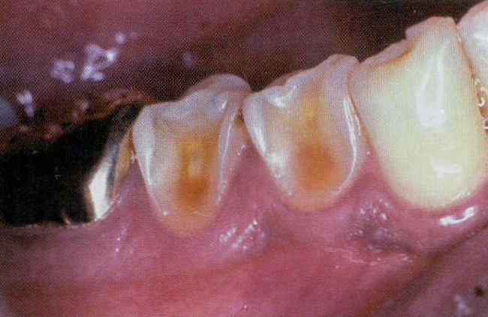
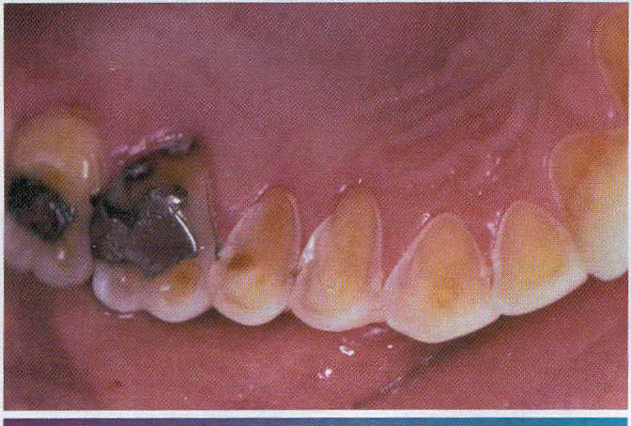

Slide 22
CLINICAL FEATURES OF EROSION
• Acids from extrinsic source cause erosion on the labial or buccal surfaces of teeth and acids from intrinsic source cause erosion on the lingual or palatal surfaces of teeth.
• The commonest site of dental erosion is the gingival third of the labial surfaces of maxillary incisors.
• In chronic severe cases of erosion, the disease can involve even the proximal surfaces of teeth besides involving the labial and lingual surfaces.
• Clinically the condition is manifested by shallow, broad, ‘scooped-out’ concavities on the enamel with highly polished surfaces.
• The shape and size of the lesion may vary considerably and it usually involves multiple teeth.
• There will be cupping of occlusal surfaces of molar teeth or grooving of the incisal edges of anterior teeth with exposure of dentin.
• Increased incisal translucency of teeth also occurs.
• In severe erosion there may be loss of entire buccal cusp of the molar teeth which results in a ‘ski slope’ like depression of the tooth that extends from lingual cusp up to the buccal cervical area.
• Erosion causes raised amalgam restorations above the level of the tooth surface. The remaining part of the tooth looks clear, polished and unstained.
• Erosion causes loss of tooth structure from the palatal surfaces of upper anteriors, which results in increased concavity.
• Amalgam restorations often have a clean, nontarnished appearance due to action of acids on the metal surface.
• Preservation of enamel “cuff” on the gingival crevice is common.

Slide 23
• Loss of enamel often causes hypersensitivity in the teeth and it may also trigger secondary dentin formation; however the tooth sensitivity occurs only in cases of rapid erosions. Sensitivity of tooth does not occur in slowly progressing erosions; as there is enough time for formation of reactionary dentin in the tooth, which protects the pulp.
• Severe cases of erosion however can cause exposure of pulp in deciduous teeth.
• Microradiography shows a gradual demineralization of surface enamel to a depth of about 100 μm.
TREATMENT
Preventive treatment: Identification of etiology is important in the management of erosion. Proper counseling is needed in case the patient is consuming excessive amount of carbonated beverages. Patients with chronic vomiting or GERD are to be referred to concerned specialists for initiation of proper therapy.
Restorative treatment: Depending upon the degree of tooth wear, restorative treatments can be undertaken to maintain the structural integrity of the eroded teeth.
ROLE OF SALIVARY FUNCTION IN THE PREVENTION OF DENTAL EROSION
Salivary function is an important factor in the prevention of erosion since buffering action of saliva can neutralize the intrinsic and extrinsic acids in the oral cavity and this in turn prevents erosion of teeth. Moreover, mineral ions in saliva can cause remineralization of the enamel damaged by the acids.

Slide 24
DENTINAL SCLEROSIS
Dentinal sclerosis is the condition characterized by calcification of the dentinal tubules of the tooth.
It is usually caused by several factors:
• Injury to dentin by caries.
• Aging process.
• Abrasion or erosion of tooth.
Dentinal sclerosis presents a translucent zone in the dentin, which can be seen when the tooth is viewed by transmitted light.
Sclerosis often decreases the conductivity of the dentinal tubules.

Slide 25
Dead Tracts
‘Dead tracts’ in dentin are seen in ground sections of teeth and are manifested as a black zone by transmitted light but as a white zone by reflected light .
This optical phenomenon is due to differences in the refractive indices of the affected tubules and normal tubules.
The nature of the change in the affected tubules is not known, although these tubules are not calcified and are permeable to the penetration of dyes.

Slide 26
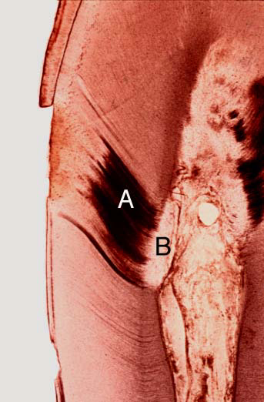
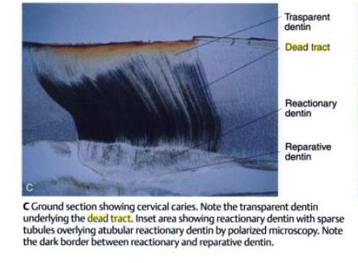

Slide 27
Secondary Dentin
Secondary dentin is dentin that is formed and deposited in response to a normal or slightly abnormal stimulus, after the complete formation of the tooth. There is a considerable variation in the composition of primary and secondary dentin. The dentinal tubules that make up dentin are generally irregular in secondary dentin and deposits contain less calcium, phosphorus, and collagenous matrix per unit volume than the primary dentin. Secondary dentin is less mineralized and contains 6–10% less mineral than primary dentin.
There are generally two types of secondary dentin, produced as a result of different stimuli. The two types of secondary dentin are physiological secondary dentin and reparative secondary dentin.

Slide 28
Physiological Secondary Dentin -This type of dentin is a regular, uniform layer of dentin around the pulp chamber that is laid down throughout the life of the tooth as a result of physiological factors generally thought to be age and tooth eruption. This type of secondary dentin is produced more slowly than primary dentin.
Reparative Secondary Dentin -Reparative secondary dentin is the dentin that forms around the pulp chamber as a result of irritation or attrition, which is a form of tooth wear. Attrition is due to tooth-to-tooth contact, which results from occlusal function, such as bruxism, and can cause loss of tooth structure. This gradual traumatic process stimulates the development of natural protective measures, such as secondary dentin.
CLINICAL FEATURES
There are no significant clinical features that may be used to determine when teeth have formed secondary dentin, although there is an evident decrease in tooth sensitivity when secondary dentin formation is extensive, as it is in elderly persons.
This type of dentin forms an additional insulating layer of calcified tissue between the pulp and the particular pathologic process that initiated the dentinal response.
Thus the eventual pulp involvement is usually delayed.
Although secondary dentin occurs in all teeth, including those of the deciduous dentition, a study by Bevelander and Benzer indicated that the anterior teeth exhibit a higher incidence of secondary dentin formation than the molar teeth.

Slide 29
Radiographic Features
Secondary dentin often may be visualized on the dental radiograph if it occurs in an area that is not overshadowed by other calcified tissue, either bone or tooth substance. Such secondary dentin formation may be noted particularly in the pulp horn areas as well as on the proximal walls of teeth with proximal caries. The decrease in size of the pulp chamber and root canals that occurs with advancing age as a result of secondary dentin formation is obvious radiographically.
Histologic Features
Physiologic secondary dentin is usually similar in appearance to primary dentin, but in decalcified stained sections it often exhibits a different tinctorial reaction and may be rather well demarcated from the primary dentin by a deeply staining ‘resting line’. This type of secondary dentin exhibits somewhat fewer tubules, although their course is not especially irregular. Adventitious secondary dentin arising in response to irritation is usually irregular in nature, being composed of few tubules that may be tortuous in appearance . In some instances tubules are inconspicuous if not completely absent. Occasionally, this secondary dentin is formed at a rapid rate and odontoblasts may become entrapped, producing a superficial resemblance to bone. Such calcified tissue has been termed osteodentin.
Stanley and his associates have studied the rate of reparative dentin formation in human teeth following cavity preparation under a variety of clinical conditions. They found that reparative dentin formation was insignificant in the first postoperative month. Between one and one-and-a-half months, new dentin formation reached a maximum rate of approximately 3.5μ per day. After this period, new dentin formation rapidly decreased.

Slide 30
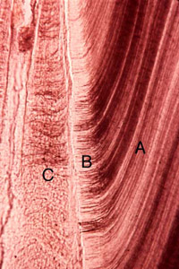
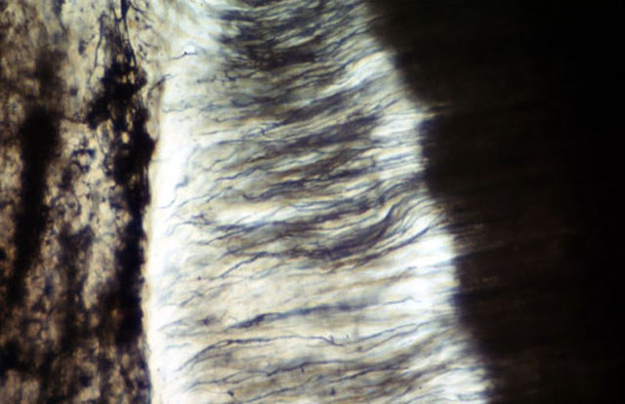
http://www.google.com.eg/imgres?imgurl=http://course.jnu.edu.cn/yxy/eruption/zuzhitupu/Images/tth/21_bb.jpg&imgrefurl=http://course.jnu.edu.cn/yxy/eruption/zuzhitupu/Cards/tth/21_bb.html&usg=__O2pfCF20OqVhn7tUN8TMsgPeRA=&h=194&w=300&sz=26&hl=ar&start=12&zoom=1&um=1&itbs=1&tbnid=Jukvk6U7SmznLM:&tbnh=75&tbnw=116&prev=/images%3Fq%3Dsecondary%2Bdentin%26um%3D1%26hl%3Dar%26tbs%3Disch:1
http://210.44.214.13/lab/Oral%20Histology%20slides/images/03_16bb.jpg

Slide 31
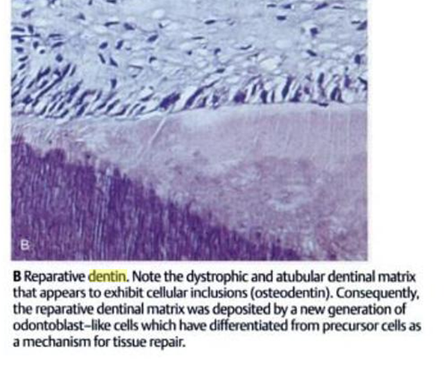
James K. Oral development and histology. 3rd e,2002

Slide 32
Reticular Atrophy of Pulp
Reticular atrophy of the pulp and more discrete vacuolization of the pulpal tissue and cells have often been described as degenerative or regressive changes of pulp, particularly when they occur as an age change in elderly persons.
It has been stated that teeth so affected are clinically symptomless and respond normally to vitality tests.
Histologically, reticular atrophy has been described as being characterized by the presence of large vacuolated spaces in the pulp, with a reduction in the number of cellular elements.
Accompanying these changes are degeneration and disappearance of the odontoblasts.

Slide 33
PULP CALCIFICATION
Deposition of calcified mass(s) within the dental pulp for no apparent reason is called pulp calcification.
Pulp calcification may be an age related process and occurs more often with increasing age; however it can also occur as a local pathologic change in the dental pulp especially in those teeth, which are subjected to trauma or chronic caries. The calcification process probably initiates in relation to the damaged pulp tissue.

Slide 34
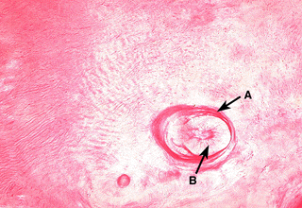
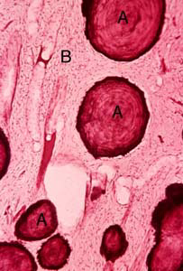
True denticle False denticle
http://www.mc.uky.edu/oaa/curriculum/md828/module4/lab/images/main/image07.gif
http://210.44.214.13/lab/Oral%20Histology%20slides/images/04_08bb.jpg

Slide 35
Causes of pulp calcification
• Idiopathic formation of pulp stones
• Formation of secondary dentin in response to caries
• Calcific metamorphosis-Pulp obliteration due to aging or trauma
• Dentinogenesis imperfecta-excessive secondary dentin formation causing pulp obliteration
• Dentin dysplasia Type-I-chevron shaped pulp chambers
• Dentin dysplasia Type- II- pulp obliteration in deciduous teeth and pulp stone formation in permanent teeth
• Ehlers-Danlos syndrome
• Regional odontodysplasia

Slide 36
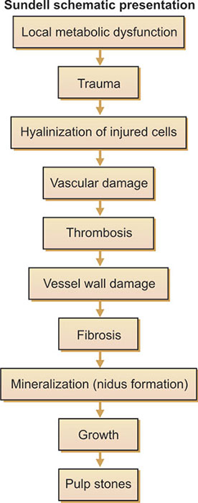
PATHOGENESIS OF PULP CALCIFICATION
The etiology of pulp calcification is unknown and it appears to be not related to inflammation, trauma or any systemic disease.
The possible pathogenesis is as follows

Slide 37
TYPES
Calcification in the pulp may be either diffuse (linear) or nodular (pulp stones).
• Denticles: These are small masses of tubular dentin formed within the pulp near the furcation area of tooth.
• Pulp stones: Pulp stones are nodular calcified bodies having an organic matrix and they occur frequently in relation to the coronal pulp. Pulp stones develop around a central nidus of pulp tissue (consisting of collagen fibrils, ground substance and necrotic cell debri).
• Diffuse linear calcifications of pulp: These are amorphous, unorganized, fine fibrilar strands of calcified masses and are typically formed within the radicular and coronal pulp.
TYPES OF PULP STONES
Pulp stones can be of two types: true and false.
A.True pulp stones are composed predominantly of dentin and have dentinal tubules. They may have an outer layer of predentin and are often located adjacent to the odontoblast cells.
B. False pulp stones are composed of concentric layers of calcified material with no tubular dentinal tubules.
According to their location in the dental pulp, stones can be described as free, attached and interstitial types.
• Free pulp stones are surrounded on all sides by pulpal tissue and are not attached to the dentinal wall.
• Attached pulp stones are those, which are attached to the dentinal wall of the pulp chamber.
• Interstitial pulp stones are those where the pulp stones have become surrounded by reactionary or secondary dentin they are called interstitial pulp stones.

Slide 38
CLINICAL SYMPTOMS
Pulp stones do not cause any clinical symptoms and the affected tooth is vital, however mild, neurologic pain has sometimes been reported in the tooth because of their presence.
DIAGNOSIS
Pulp calcifications can be detected by the following methods:
• Large pulp stones are often detected by radiographs.
• Ground section preparation of the affected tooth.
• Microscopic examination helps in differentiating between the true and false pulp stones (on the basis of presence or absence of dentinal tubules).
• Serial sectioning of tooth or multiple radiographs taken at different angles may help to detect whether the pulp stone is free or attached to the dentinal wall.
CLINICAL SIGNIFICANCE OF PULP CALCIFICATIONS
Both pulp stones and dystrophic pulp calcifications may cause difficulties during endodontic treatment of the affected tooth.

Slide 39
RESORPTION OF TEETH
Resorption of teeth can be defined as a chronic progressive damage or loss of tooth structures (mostly roots of the teeth or sometimes crowns) due to the action of some specialized cells called odontoclasts.
Pathological resorption may be external or internal.

Slide 40
EXTERNAL RESORPTION
It is lytic process occurring in the cemetum or cementum and dentin of the roots of teeth.
Factors associated with external resorption:
Cyst & tumors.
Dental trauma.
Excessive mechanical forces.
Excessive occlusal forces.
Grafting of alveolar clefts.
Hormonal imbalances.
Intracoronal bleaching of pulpless teeth.
Local involvement by herpes zoster.
Paget’s disease of bone.
P.D treatment.
P.A inflammation.
Pressure from impacted teeth.
Reimplantation of teeth.
Idiopathic.

Slide 41
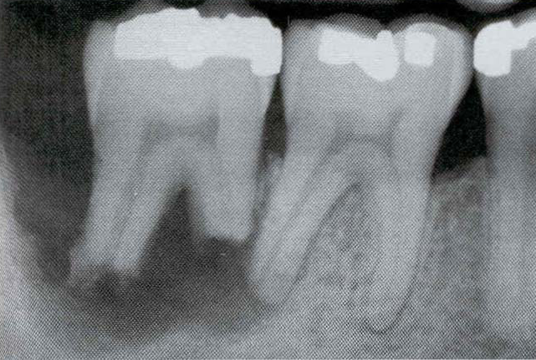
Radiographically, appears as a “moth-eaten” loss of tooth structure in which the radiolucency is less well defined and demonstrates variation in density.

Slide 42
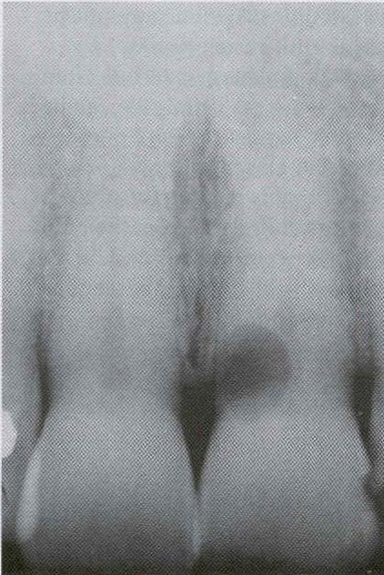
Invasive cervical resorption
Multiple idiopathic root resorption: several teeth may be involved, and underlying cause for the accelerated destruction may not be obvious.

Slide 43
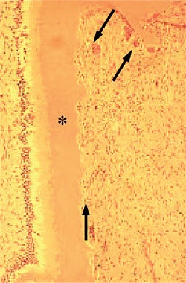
Histopathologically, numerous multinucleated dentinoclasts located in the areas of structure loss. Areas of resorption often are repaired through deposition of osteodentin. In large defects, external inflammatory R. results in deposition of inflamed granulation tissue, and areas of replacement with woven bone may also be seen.
http://www.google.com.eg/imgres?imgurl=http://www.endodoncja.pl/zdj/rozne04/foto35.jpg&imgrefurl=http://www.endodoncja.pl/rozne04.html&usg=__7coZWKXm8t_mkzXH8kgok6bvC3Y=&h=364&w=250&sz=25&hl=ar&start=7&zoom=1&um=1&itbs=1&tbnid=8yMlzGlKhHY60M:&tbnh=121&tbnw=83&prev=/images%3Fq%3Dexternal%2Bresorption%2Bhistological%26um%3D1%26hl%3Dar%26sa%3DN%26tbs%3Disch:1

Slide 44
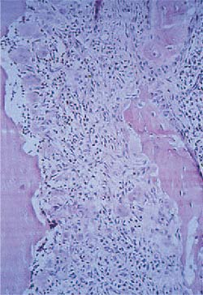
Histologic appearance of a tooth exhibiting
external inflammatory root resorption, showing multinucleated clast cells adjacent to resorbed dentin and bone. A chronic inflammatory cellular infiltrate is also evident in the area.
http://www.endodoncja.pl/zdj/rozne04/foto35.jpg

Slide 45
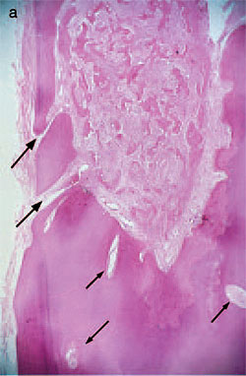
Histologic appearance of an extensive invasive cervical resorption with radicular extensions. Masses of ectopic calcific tissue are evident both within the fibrovascular tissue occupying the resorption cavity and on resorbed dentin surfaces. In addition, communicating channels can be seen connecting with the periodontal ligament (large arrows). Other channels can be seen within the inferior aspect of the radicular dentine (small arrows). (Hematoxylin–eosin stain)

Slide 46
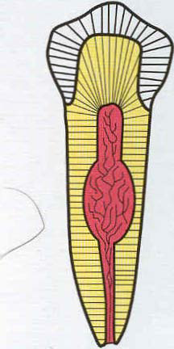
Internal resorption
Two main patterns:
Inflammatory R.:
It occurs duo to intense inflammatory reaction within the pulp tissue.
The resorbed dentin is replaced by inflamed granulation tissue.

Slide 47
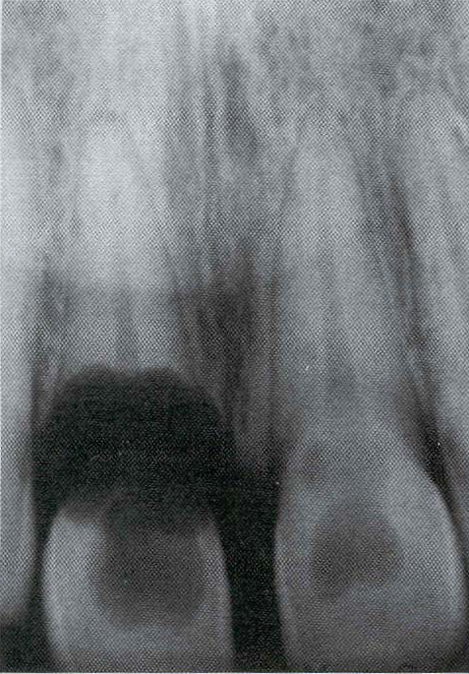
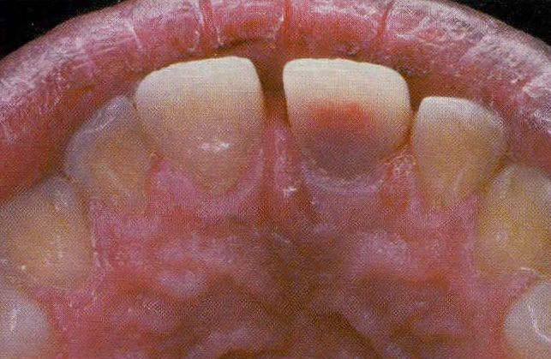
Radiographically, a uniform, well-circumscribed symmetric radiolucent enlargement of the pulp chamber or canal.
Internal resorption ( pink tooth of Mummery)

Slide 48
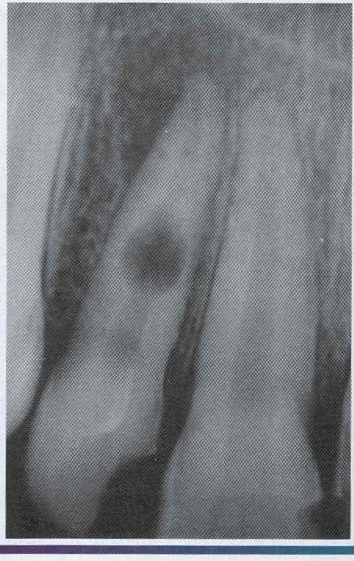
Internal resorption. Balloon like enlargement of the root canal

Slide 49
Histopathology :
The pulp tissue in the area of destruction is vascular and exhibits increased cellularity and collageniztion.
Immediately adjacent to the dentinal wall are numerous multinucleated dentinoclasts, which are histologically and functionally identical to osteoclasts.
An inflammatory infiltrate characterized by lymphocytes, histiocytes, and PMN leukocytes is not uncommon.

Slide 50
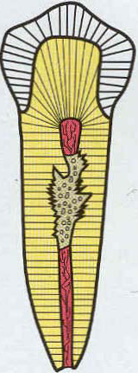
2. Replacement or metaplastic resorption:
It occurs duo to absence of any inflammatory reaction within the pulp.
Portions of the pulpal dentinal walls are resorbed and replaced with bone or cementum-like bone.

Slide 51
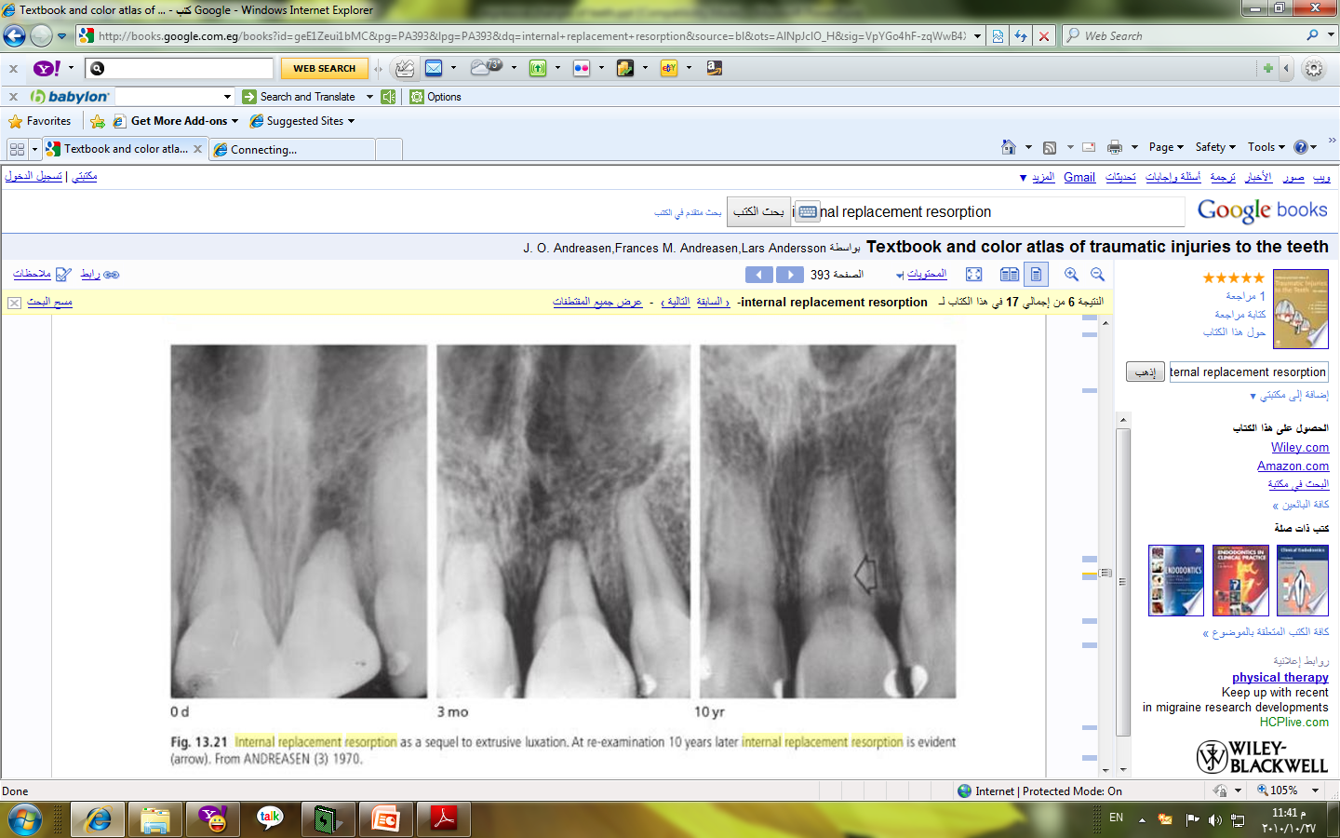
Radiographically, appears as an enlargement of the canal that is filled with a material that is less radiodense than the surrounding dentin. The outline of destruction is less defined.
J. O. Andreasen. Textbook and color atlas of traumatic injuries to the teeth
Histopathologically, the normal pulp tissue is replaced by woven bone that fuses with the adjacent dentin.

Slide 52
Hypercementosis ( Cementum hyperplasia)
It is a non- neoplastic condition in which excessive cementum is deposited in continuation with the normal radicular cementum.
It may be regarded as a regressive change of teeth characterized by excessive amounts of secondary cementum on root surfaces.
Types:
Localized & Generalized
Etiology:
Accelerated elongation of a tooth.
Inflammation about a tooth.
Tooth repair.
Osteitis deformans, or Paget’s disease of bone.
Others: hyperpituitarism, cleidocranial dysostosis.

Slide 53
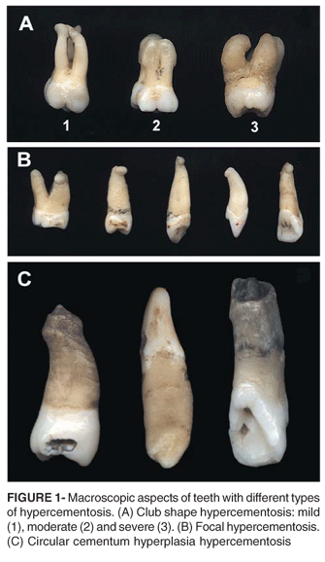
http://www.scielo.br/img/revistas/jaos/v16n6/a05fig01.gif

Slide 54
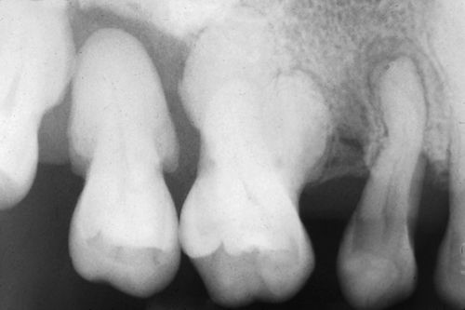
http://medicaldictionary.thefreedictionary.com/_/viewer.aspx?path=mosby&name=500105-fx12.jpg

Slide 55
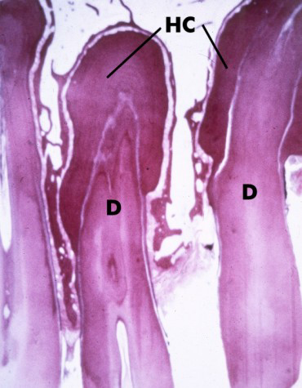
Excessive amount of secondary or cellular cementum deposited directly, over typically thin primary acellular cementum. Secondary cementum is called osteocementum duo to its cellular nature and its resemblance to bone. Cementum typically arranges in concentric layers around the root and frequently shows numerous resting lines parallel to root surface.
http://www.dental.pitt.edu/informatics/periohistology/en/cementum/histo123a2.htm

Slide 56
AGE CHANGES IN TEETH
Age changes in teeth include the changes in structure and composition of the dental tissues as well as the changes in morphology associated with tooth wear.
CHANGES IN ENAMEL
• Enamel becomes more brittle with age.
• Less permeable for the ionic exchanges as the intercrystalline pores become smaller and smaller with age.
• More and more darkening due to absorption of organic materials.
• Enamel is progressively worn away with age, in the regions of masticatory attrition.
• Decrease in the amount of water content in enamel tissue.
• Progressive increase in the fluoride content of surface enamel due to ionic exchanges with the oral fluid, which causes conversion of hydroxyapatite crystals of enamel into fluroapatite crystals.
• Progressive decrease in the incidence of caries.

Slide 57
CHANGES IN DENTIN
• Continuous formation of secondary dentin causing reduction in size and even obliteration of the pulp chamber.
• Dentinal sclerosis due to continued production of peritubular dentin.
• Roots of the teeth become more brittle due to dentinal sclerosis.
• Sclerosis of dentin also causes increasing translucency of the roots.
• Root translucency of tooth starts at the apex and extends coronally with age; therefore this phenomenon can be used as a guideline in forensic odontology as a method of age determination of person.

Slide 58
CHANGES IN CEMENTUM
• Cementum continues to form in the apical third of the root throughout life.
• Increase in the thickness of cementum at the root-end helps to compensate for the occlusal and interproximal attrition of tooth.
• The amount of secondary cementum apposition increases with age and it can be an important factor in age determination in forensic dentistry.
• Besides cementum appositions, there can be areas of cemental resorptions with increasing age.
CHANGES IN PULP
Following changes always occur in the pulp tissue with age:
• Decreased cellularity
• Reduced vascularity.
• Increased fibrosis due to continued formation of collagen fibers.
• Pulpal response to tissue injury can be impaired, which may cause reduced healing potential.
• Pulp volume gradually decreases with continued production of secondary dentin.
• Incidence of pulp calcification will be higher with age.

Slide 59
Cementicles
Small foci of calcified tissue, not necessarily true cementum, which lie free in P.D.L of the lateral and apical root areas.
The exact cause is unknown, but they represent areas of dystrophic calcification and thus are an example of a regressive or degenerative change.
Formation :
Types:
1. Free Cementicles
2. Attached or sessile Cementicles
3. Embedded Cementicles

Slide 60
PATHOGENESIS
Cementicles may develop in the following manner:
• Calcification of the epithelial cell rest of Malassez in the periodontal ligament tissue.
• Calcification of the soft tissue between the Sharpey’s fiber bundles.
• Fragmentation and detachment of small piece of cementum from the root surface due to excessive force on the tooth.
• Calcification of thrombosed blood capillaries within the periodontal ligament. Cementicles are not necessarily the mass of true cementum, any calcified tissue including alveolar bone are collectively referred to as cementicles. Their size can increase due to further disposition of calcium. Cementicles are not usually visible in the radiograph and they do not have any clinical significance.

Slide 61
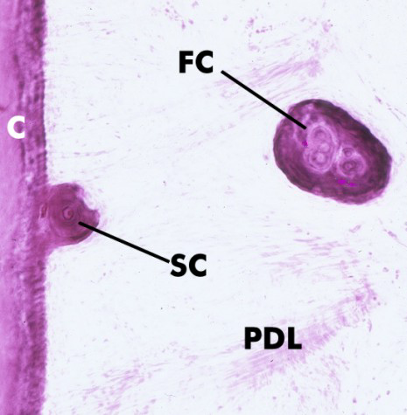
http://www.dental.pitt.edu/informatics/periohistology/en/cementum/histo125Aa2.htm

Slide 62
Take home message
Regressive alteration is a multifactorial condition causing loss of enamel and dentine.
The cause is generally erosion, attrition, abrasion, abfraction and resorption or a combination of this lesions.

Slide 63
Question & Answer Session
WRITE A NOTE ON DENTINAL SCLEROSIS .
PATHOGENESIS OF PULP CALCIFICATION.
WRITE ABOUT INTERNAL RESORBTION.
FACTORS AFFECTING EROSION OF TOOTH.
WRITE ABOUT ATTRITION,ABFRACTION,ABRATION.

Slide 64
References
Shafer’s textbook of Oral Pathology
Essentials of Oral Pathology
Oral and Maxillofacial Pathology- Neville

Slide 65
THANK YOU

